Slide 1
CS112: Introduction to Python programming
Week 12: Class

Slide 2
Object-oriented programming (OOP)
Object-oriented programming (OOP)（面向对象编程） is a programming paradigm based on the concept of "objects", which can contain data and code. The data is in the form of fields (often knowns attributes or properties), and the code is in the form of procedures (often known as methods).
Python is an OOP language. Almost everything in Python is an object, with its properties and methods.

Slide 3
Class
Class(类): definition of a particular kind of object, including its features and how it is implemented in code; a template that is used to generate objects;
Objects can contain data and have associated methods.
A class can be a data type such as string or set, but also something more complex like people, company,rocket, etc. Any object capable of being abstracted can be a class.
Object(对象): A specific instance(实例) of the class

Slide 4
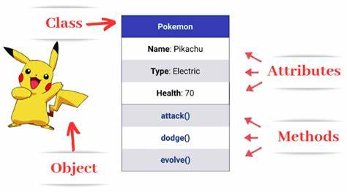
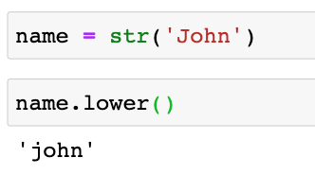
Class
Python is an object-oriented language.
Attributes(属性) are variables associated with all the objects of a class. Whenever an object is created from a class, this object inherits the variable of the class.
Methods(方法) are functions associated with an object.

Slide 5
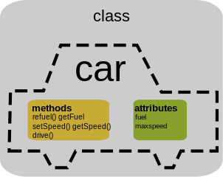
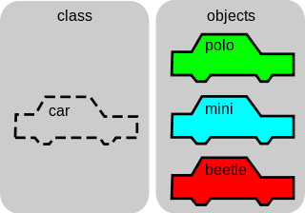
Class
A Class is like an object constructor, or a "blueprint" for creating objects.
An Object is an instance of a Class. An Object is a copy of the class with actual values.

Slide 6
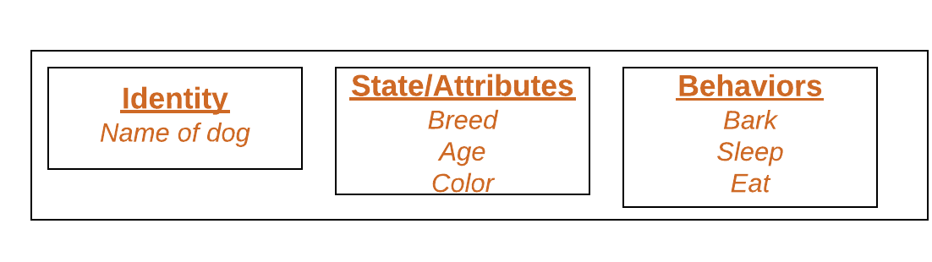
Object
An object consists of :
Identity: It gives a unique name to an object and enables one object to interact with other objects.
States/Attributes: It reflects the properties of an object.
Behaviors: It is represented by the methods of an object. It also reflects the response of an object to other objects.
https://www.geeksforgeeks.org/python-classes-and-objects/

Slide 7
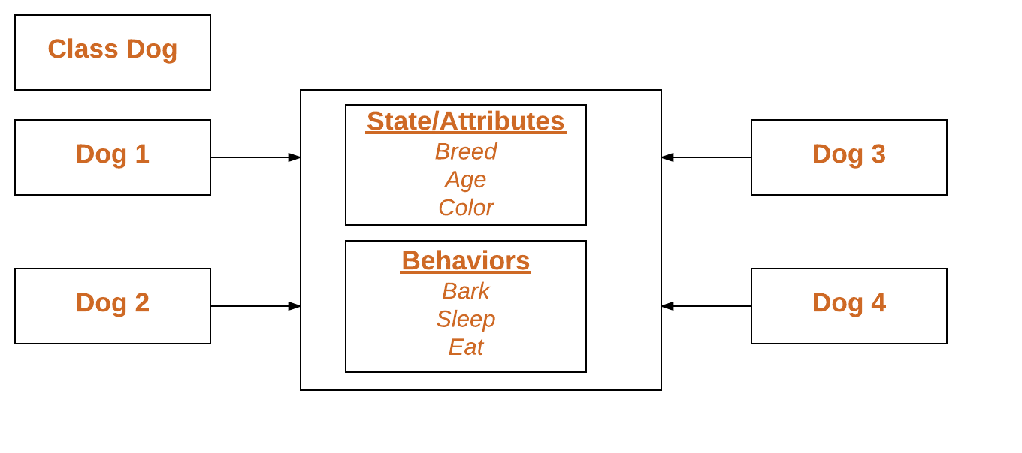
Object
Declaring Objects (Also called instantiating （实例化）a class)
All the objects share the attributes and the behavior of the class. But the values of those attributes are unique for each object.
A single class may have any number of objects.

Slide 8
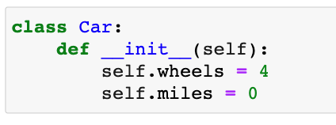
Creating classes
Classes are the template of the objects. The syntax to create classes in Python is very simple:
class NAME:
[body]
Self is a variable that is used to represent the instance of the Class
_init_ is a special method that doesn’t return any value.
It is excuted whenever an instance of the Class is created. It is used to customize a specific initial state.

Slide 9
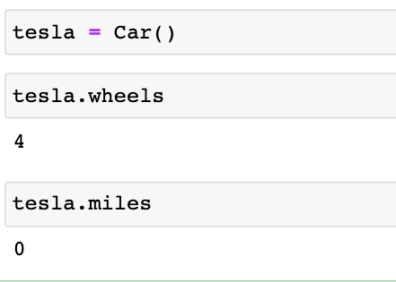
The __init__() function
All classes have a function called __init__(), which is always executed when the class is being initiated.
Use the __init__() function to assign values to object properties, or other operations that are necessary to do when the object is being created:
We can access the instance attributes and methods using the object and dot (.) operator.

Slide 10
The self parameter
Class methods must have an extra first parameter (usually named as self) in the method definition.
We do not give a value for this parameter when we call the method, Python provides it.
If we have a method that takes no arguments, we still have one argument.
When we call a method of the object as myobject.method(arg1, arg2), this is automatically converted by Python into MyClass.method(myobject, arg1, arg2)

Slide 11
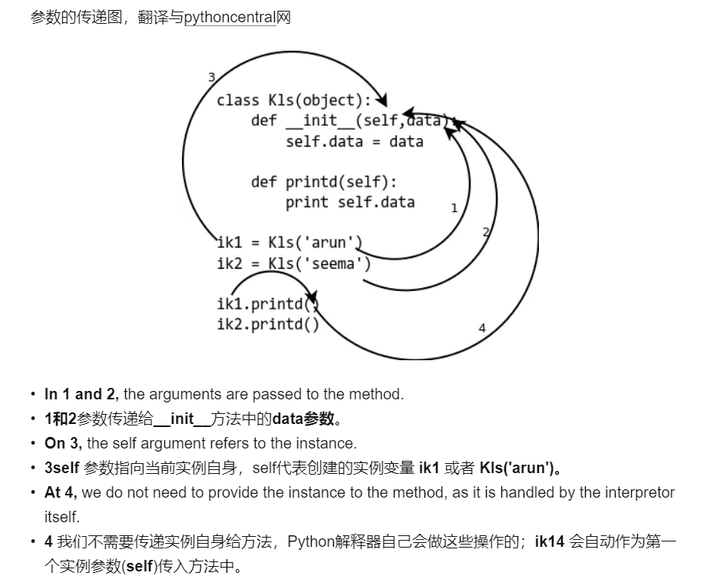
Class中参数的传递

Slide 12
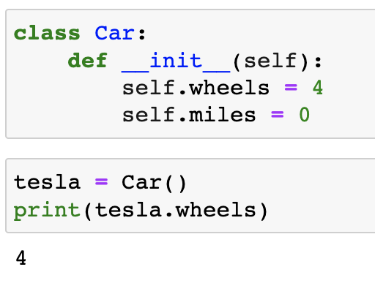
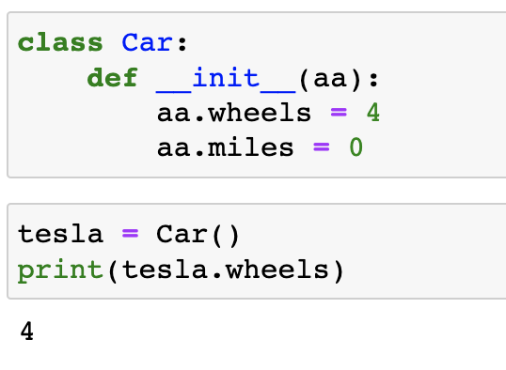
The self parameter
It does not have to be named self, you can call it whatever you like, but it has to be the first parameter of any function in the class.

Slide 13
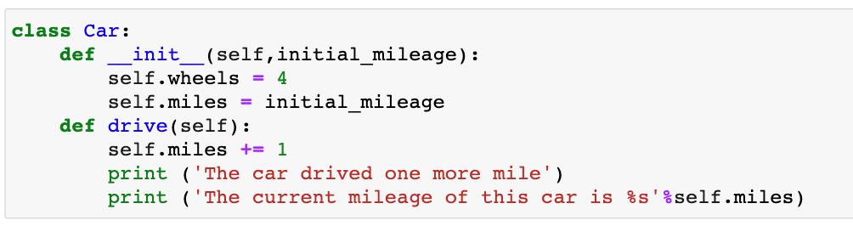
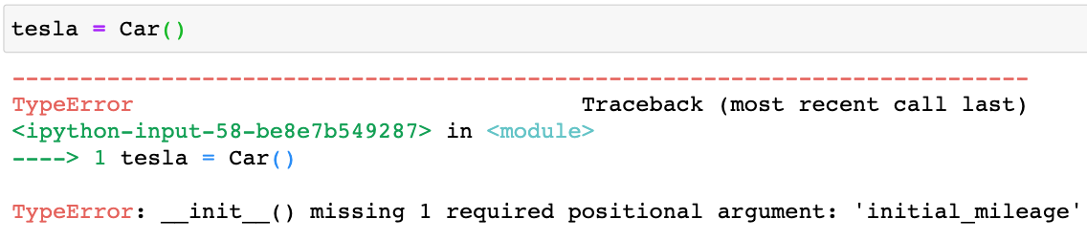
Classes with arguments

Slide 14
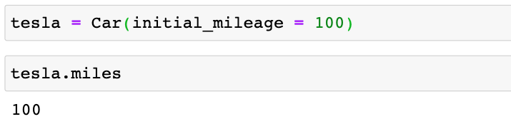
Classes with arguments

Slide 15
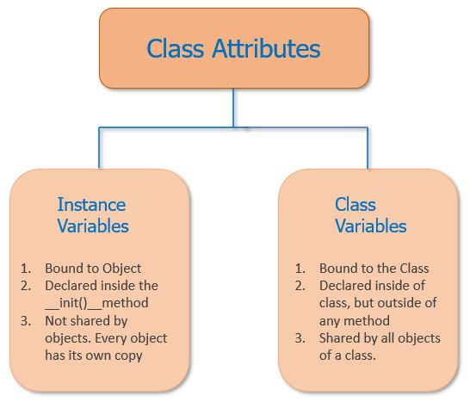
Instance and Class variables
In Class, attributes can be defined into two parts:
Instance variables: The instance variables are attributes attached to an instance of a class. We define instance variables in the constructor ( the __init__() method of a class).
Class Variables: A class variable is a variable that is declared inside of class, but outside of any instance method or __init__() method.

Slide 16
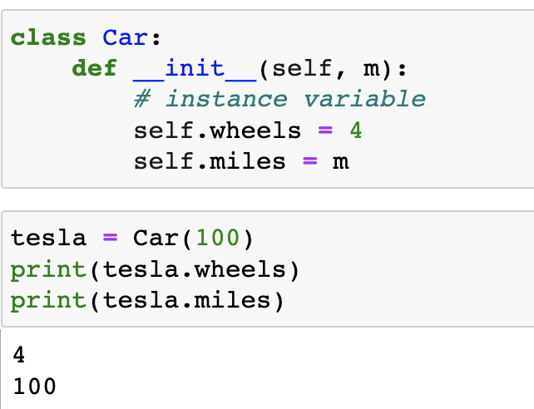
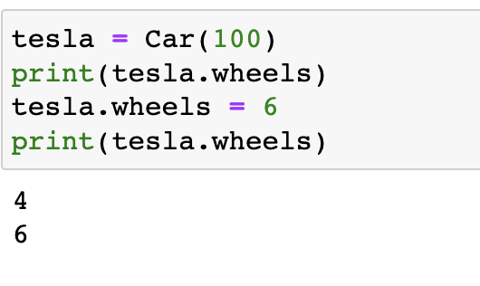
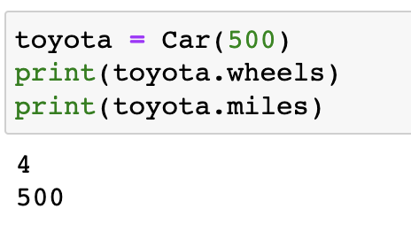
Instance variables
It is possible to change the value of the attribute of an instance
This change is specific for the instance. When new instances are created, the method __init__ is executed again to assign the attribute to the new instance

Slide 17
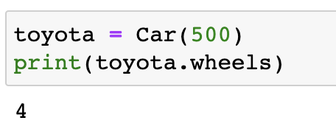
Instance variables
It is possible to change the value of the attribute of an instance
This change is specific for the instance. When new instances are created, the method __init__ is executed again to assign the attribute to the new instance

Slide 18
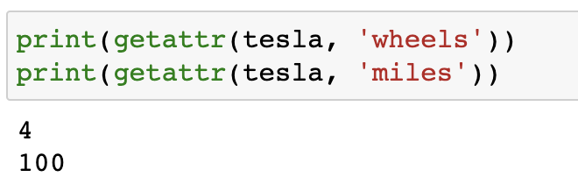
Access instance variables
getattr(object, name[, default])
Get a named attribute from an object; getattr(x, 'y') is equivalent to x.y.

Slide 19
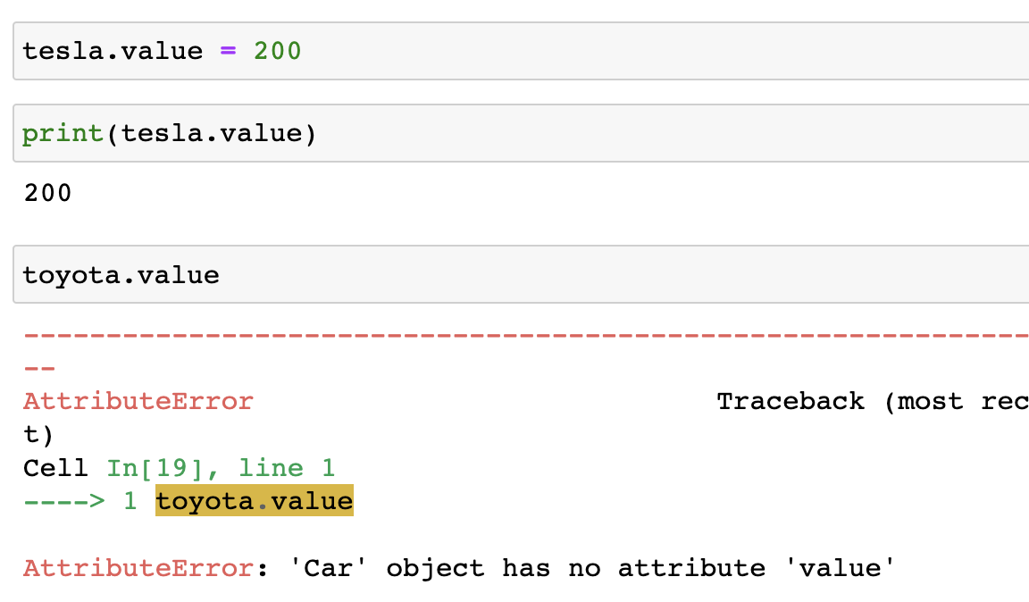
Dynamically add instance variables

Slide 20
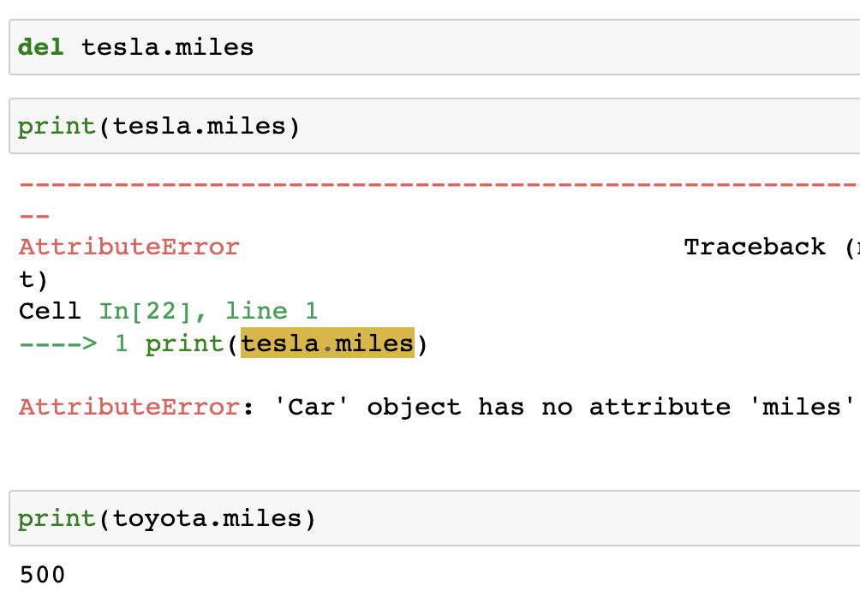
Dynamically delete instance variables

Slide 21
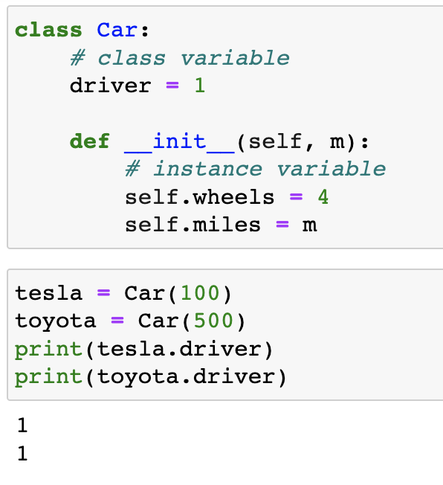
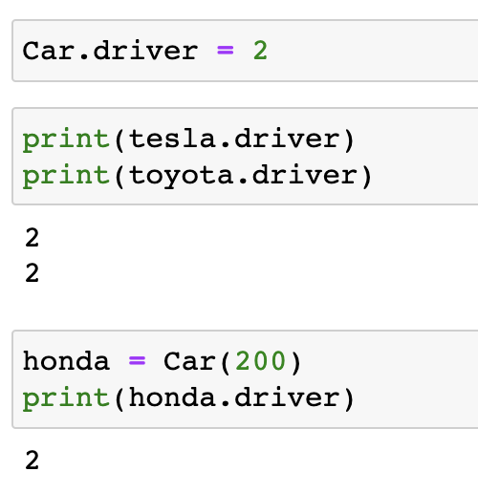
Class variables

Slide 22
The __str__() function
The __str__() function controls what should be returned when the class object is represented as a string.
If the __str__() function is not set, the string representation of the object is returned
class Person: def __init__(self, name, age): self.name = name self.age = age def __str__(self): return f"{self.name}({self.age})" p1 = Person("John", 36) print(p1)
class Person: def __init__(self, name, age): self.name = name self.age = age p1 = Person("John", 36) print(p1)
<__main__.Person object at 0x2ae2083ab100>
John(36)
OUTPUT

Slide 23
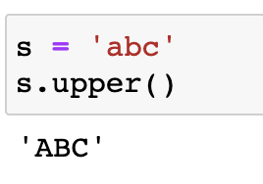
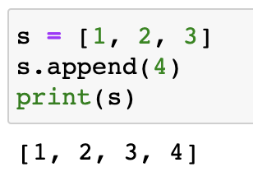
Class methods
Each class instance can have attributes attached to it for maintaining its state. Class instances can also have methods (defined by its class) for modifying its state.

Slide 24
Class methods
Inside a Class, we can define the following three types of methods.
Instance method(实例方法): Used to access or modify the object state. If we use instance variables inside a method, such methods are called instance methods. It must have a self parameter to refer to the current object.
Class method(类方法): Used to access or modify the class state. In method implementation, if we use only class variables, then such type of methods we should declare as a class method. The class method has a cls parameter which refers to the class.
Static method(静态方法): It is a general utility method that performs a task in isolation. Inside this method, we don’t use instance or class variable because this static method doesn’t take any parameters like self and cls.

Slide 25
Instance methods
Instance methods are functions that belong to the object.
Used to access or modify the object state.
Use instance variables inside a method.
Must have a self parameter to refer to the current object.

Slide 26
Instance methods
class Person: def __init__(self, name, age): self.name = name self.age = age def myfunc(self): print("Hello my name is " + self.name) p1 = Person("John", 36) p1.myfunc()
OUTPUT
Hello my name is John

Slide 27
Instance methods
class Student:
def __init__(self, name, age):
# Instance variable
self.name = name
self.age = age
# inst. method to modify inst. var.
def update_age(self, age):
self.age = age
# inst. method to add inst. var.
def add_marks(self, marks):
self.marks = marks
# create object
stud = Student("Emma", 14)
print(stud.name, stud.age)
# call instance method
stud.update_age(18)
stud.add_marks(75)
print(stud.name, stud.age, stud.marks)
OUTPUT
Emma 14
Emma 18 75

Slide 28
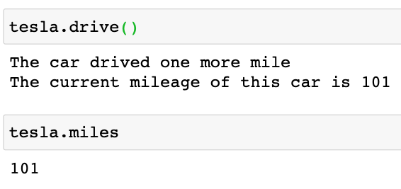
Instance methods

Slide 29
Class methods
Used to access or modify the class state.
To make a method as class method, add @classmethod decorator before the method definition, and add cls as the first parameter to the method.
The @classmethod decorator is a built-in function decorator. In Python, we use the @classmethod decorator to declare a method as a class method.
Syntax for creating a class method
class C(object):
@classmethod
def fun(cls, arg1, arg2, ...):
....
https://www.geeksforgeeks.org/python-classes-and-objects/

Slide 30
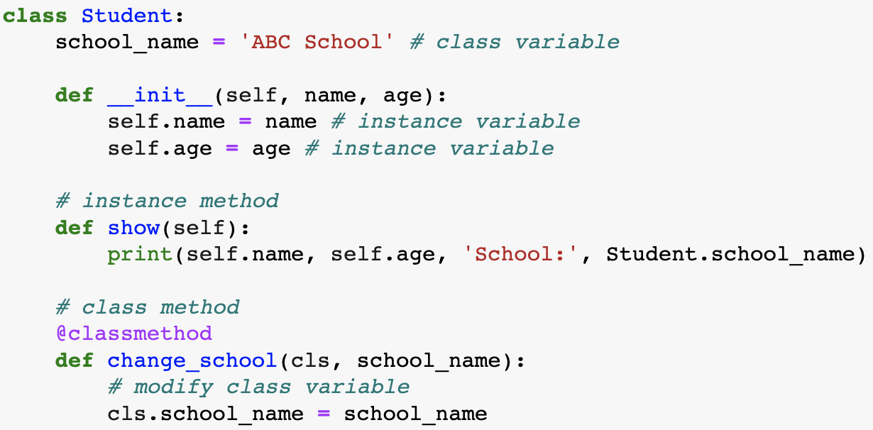
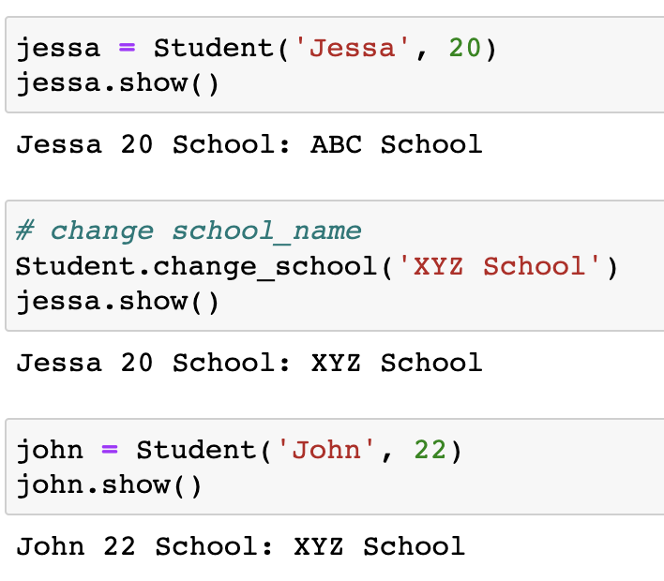
Class methods
The class method can be called using ClassName.method_name()

Slide 31
Static methods
A static method is bound to the class and not the object of the class. Therefore, we can call it using the class name.
A static method doesn’t have access to the class and instance variables because it does not receive an implicit first argument like self and cls. Therefore it cannot modify the state of the object or class.
To make a method a static method, add @staticmethod decorator before the method definition.
class C(object):
@staticmethod
def fun(arg1, arg2, ...):
...
https://www.geeksforgeeks.org/python-classes-and-objects/

Slide 32
Static methods
class Person:
def __init__(self, name, age):
self.name = name
self.age = age
# a static method to check if a Person is adult or not.
@staticmethod
def isAdult(age):
return age > 18
p1 = Person('mayank', 21)
print(p1.age)
# print the result
print(Person.isAdult(22))
OUTPUT
21
True
https://www.geeksforgeeks.org/python-classes-and-objects/

Slide 33
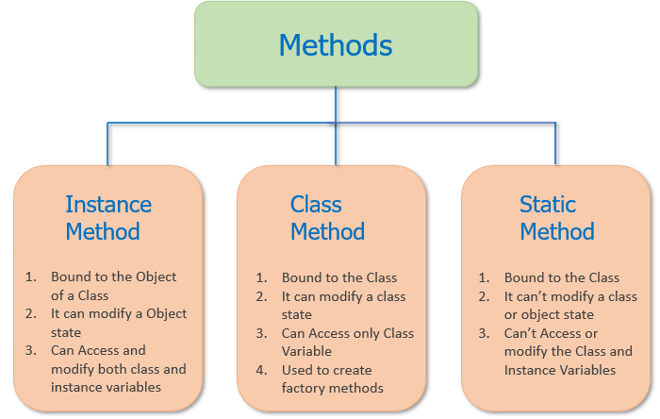
Class methods
实例方法：随着实例属性的改变而改变
类方法，雷属性的值不随实例属性的辩护阿尔变化
静态方法：不可以访问类属性，直接输出传人方法的值
通常情况下，在类中定义的方法默认都是实例方法。
Python 类方法和实例方法相似，它最少也要包含一个参数，只不过类方法中通常将其命名为 cls，
静态方法，其实就是我们学过的函数，和函数唯一的区别是，静态方法定义在类这个空间（类命名空间）中
在实际编程中，几乎不会用到类方法和静态方法，因为我们完全可以使用函数代替它们实现想要的功能，但在一些特殊的场景中可使用类方法和静态方法。

Slide 34
Inheritance
Inheritance allows us to define a class that inherits all the methods and properties from another class.
Parent class is the class being inherited from, also called base class.
Child class is the class that inherits from another class, also called derived class.
It is transitive in nature, which means that if class B inherits from another class A, then all the subclasses of B would automatically inherit from class A.

Slide 35
Inheritance
The main purpose of inheritance is the reusability of code because we can use the existing class to create a new class instead of creating it from scratch.
In inheritance, the child class acquires all the data members, properties, and functions from the parent class. Also, a child class can also provide its specific implementation to the methods of the parent class.
For example, In the real world, Car is a sub-class of a Vehicle class. We can create a Car by inheriting the properties of a Vehicle such as Wheels, Colors, Fuel tank, engine, and add extra properties in Car as required.

Slide 36
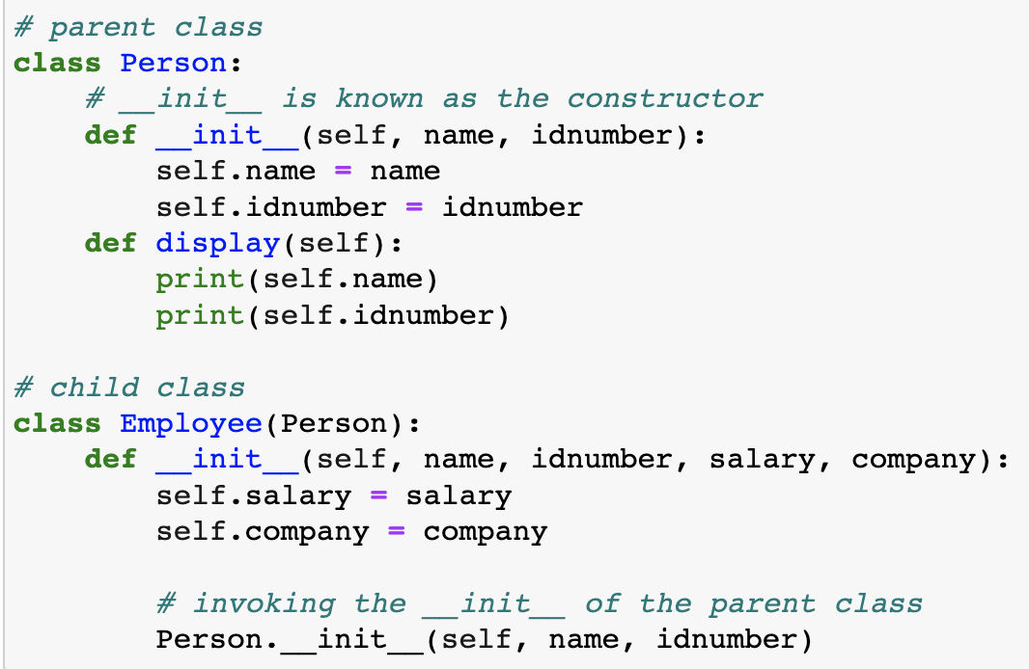
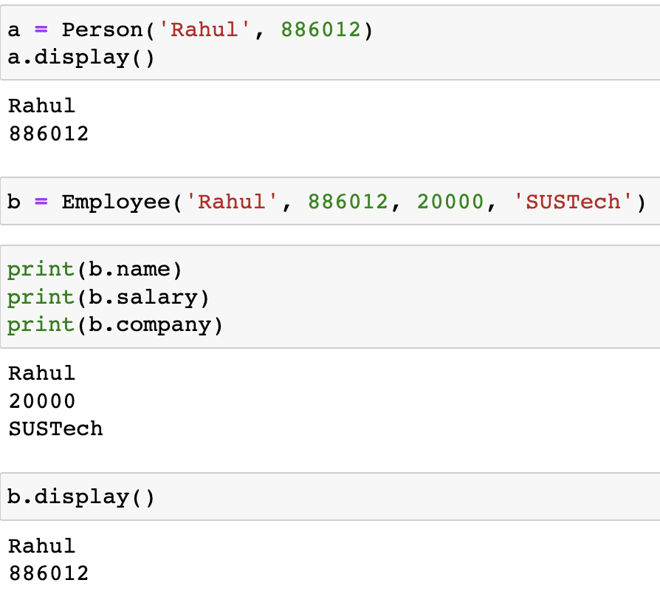
Inheritance

Slide 37
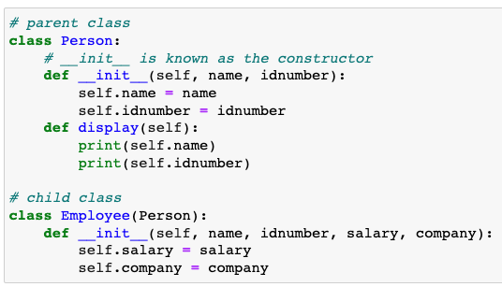
Inheritance
Python program to demonstrate error if we forget to invoke __init__() of the parent
If you forget to invoke the __init__() of the parent class then its instance variables would not be available to the child class.

Slide 38
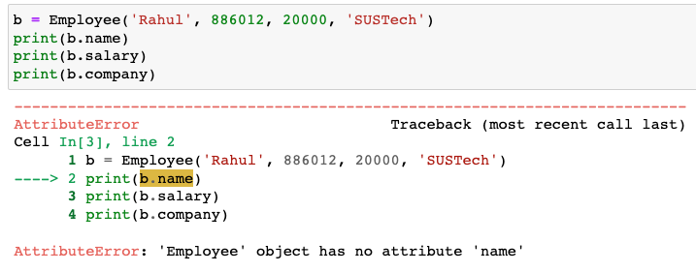
Inheritance

Slide 39
Inheritance
Different types of Inheritance:
Single inheritance: When a child class inherits from only one parent class, it is called single inheritance. We saw an example above.
Multiple inheritances: When a child class inherits from multiple parent classes, it is called multiple inheritances.

Slide 40
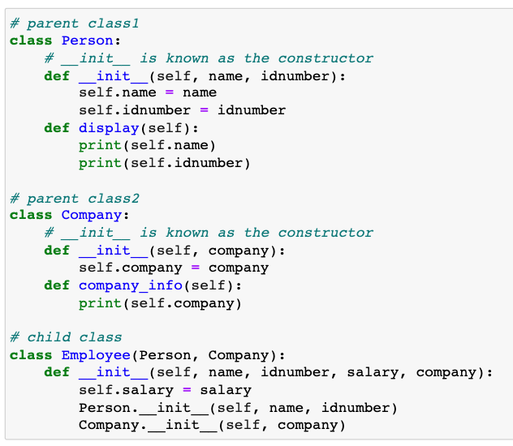
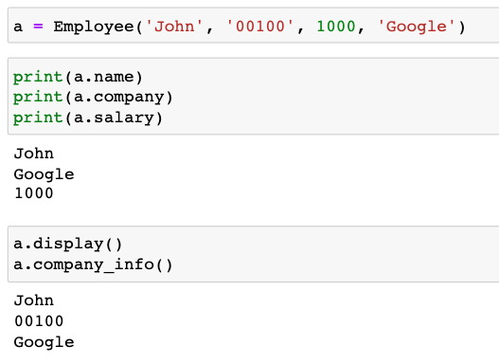
Multiple inheritances

Slide 41
Inheritance
In Python, based upon the number of child and parent classes involved, there are five types of inheritance. The type of inheritance are listed below:
Single inheritance
Multiple Inheritance
Multilevel inheritance
Hierarchical Inheritance
Hybrid Inheritance

Slide 42
exercise
https://pythongeeks.org/quizzes/python-classes-quiz/
https://pynative.com/python-object-oriented-programming-oop-exercise/

